Slide 1
Big Data Analytics and Mining
Junming Shao

Slide 2
Lecture 5
Data Stream Mining

Slide 3
Outline
What is data stream?
What is Concept Drift?
Concept drift detection
Data stream classification
Data stream clustering

Slide 4

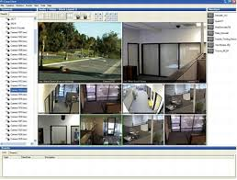


Internet
Surveillance
Spam Filtering
DATA STREAM
Network Intrusion
Industry
Mobile
Smart Phone
Sensor
*Note: some pictures derived from internet

Slide 5
Potential Applications
Telecommunication calling records
Business: credit card transaction flows
Network monitoring and traffic engineering
Financial market: stock exchange
Engineering & industrial processes: power supply & manufacturing
Sensor, monitoring & surveillance: video streams, RFIDs
Security monitoring
Web logs and Web page click streams

Slide 6
What is data stream?
A data stream is a massive sequence of data objects which have some unique features:
One by One
Potentially Unbounded
Concept Drift
data4
data3
data2
data1
Data mining system
Data stream

Slide 7
Challenges
Data Stream: (a) Infinite Length (b) Evolving Nature
Single Pass Handling
Memory Limitation
Low Time Complexity
Concept Drift

Slide 8
What is concept drift？
In predictive analytics and machine learning, the concept drift means that the statistical properties of the target variable, which the model is trying to predict, change over time in unforeseen ways.
In a word, the probability distribution changes.
Change in P(C)
Change in P(X)
Change in P(C|X)

Slide 9
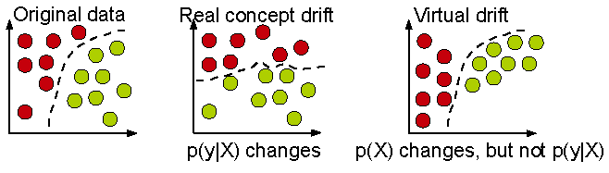
Real concept drift vs. Virtual concept drift

Slide 10
Example: Concept-Drift
Current hyperplane
Previous hyperplane
A data chunk
Negative instance
Instances victim of concept-drift
Positive instance
Notes:
Suppose we divide the data stream into equal sized chunks
This is a data chunk, where each data point is two dimensional
A hyperplane separates the data points into two classes: positive and negative
Suppose this is the next data chunk
We see that the hyperplane has shifted
As a result, some data points that were negative according to the previous hyperplane, are now positive -> this indicates concept-drift
In the next data chunk, we see again the hyperplane has shifted, and some data points changed their label
10

Slide 11
1、 Concept Drift Detection

Slide 12
1. Distribution-based detector
Monitoring the change of data distributions between two fixed or adaptive windows of data. (e.g. ADWIN)
w₁
w₂
Hard to determine window size
Learn concept drift slower
Virtual concept drift

Slide 13
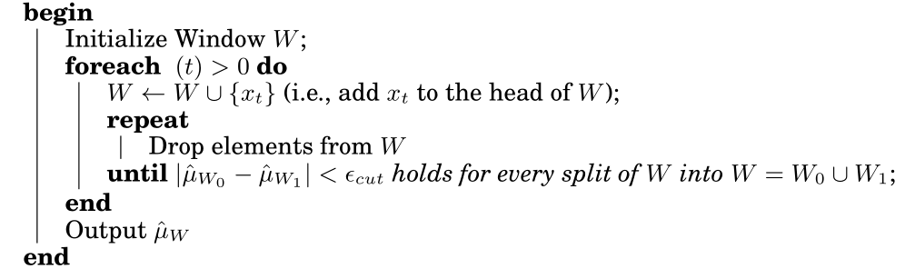
Adaptive Windowing（ADWIN）
The idea is simple: whenever two “large enough” subwindows of W exhibit “distinct enough” averages, one can conclude that the corresponding expected values are different,and the older portion of the window is dropped.
Bifet et al., Learning from Time-Changing Data with Adaptive Windowing

Slide 14
2. Error-rate based detector
Capture concept drift based on the change of the classification performance. (i.e. comparing the current classification performance to the average historical error rate with statistical analysis.) (e.g. PHT)
Infer time-changing concept relying on performance degradation
Indirectly
Sensitive to noise
Hard to deal with gradual concept drift
Depend on learning model itself heavily

Slide 15
Drift detection method: DDM
A significant increase in the error of the algorithm, suggest a change in the class distribution, and whether is a significant increase is based on following formula.
the error-rate is the probability of observed False,
, with standard deviation given by

Slide 16
2、Data Stream Classification

Slide 17
Data stream classification
Classification: Model construction based on training sets
Typical classification methods
K-Nearest neighbor approach
Decision tree
Bayesian classification
Neural network approach
Support Vector Machines
Other methods
Are these approaches ok for data stream classification?

Slide 18
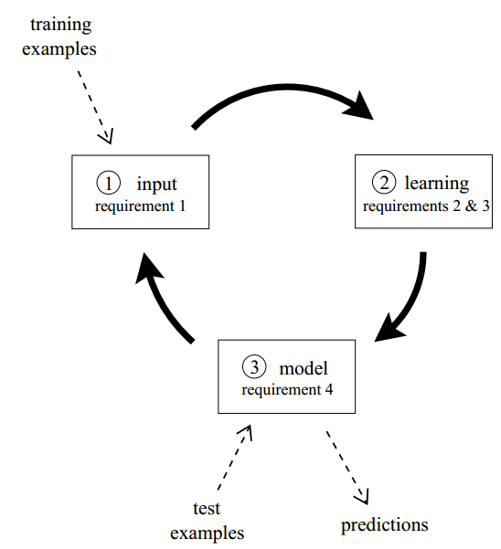
Data stream classification Circle
Process an example at a time, and inspect it only once
Be ready to predict at any point
Use a limited amount of memory
Work in a limited amount of time

Slide 19
Procedure
The algorithm is passed the next available example from the stream (requirement 1)
The algorithm processes the example, updating its data structures. It does so without exceeding the memory bounds set on it (requirement 2), and as quickly as possible (requirement 3).
The algorithm is ready to accept the next example. (requirement 4)

Slide 20
Typical algorithms
VFDT (Very Fast Decision Tree, KDD’00)
CVFDT (KDD’01)
SyncStream (Shao et al., KDD’14)

Slide 21
Decision Tree Learning
One of the most effective and widely-used classification methods
Induce models in the form of decision trees
Each node contains a test on the attribute
Each branch from a node corresponds to a possible outcome of the test
Each leaf contains a class prediction
Age<30?
Yes
No
Car Type=
Sports Car?
Yes
Yes
No
No

Slide 22
Challenges
Classic decision tree learners assume all training data can be simultaneously stored in main memory
Disk-based decision tree learners repeatedly read training data from disk sequentially
Prohibitively expensive when learning complex trees
Goal: design decision tree learners that read each example at most once, and use a small constant time to process it

Slide 23
VFDT (Very Fast Decision Tree)
A decision-tree learning system based on the Hoeffding tree algorithm
In order to find the best attribute at a node, it may be sufficient to consider only a small subset of the training examples that pass through that node.
Given a stream of examples, use the first ones to choose the root attribute.
Once the root attribute is chosen, the successive examples are passed down to the corresponding leaves, and used to choose the attribute there, and so on recursively.
Use Hoeffding bound to decide how many examples are enough at each node

Slide 24
How many examples are enough?
Let G(X_{i}) be the heuristic measure used to choose test attributes (e.g. Information Gain, Gini Index)
X_{a} : the attribute with the highest attribute evaluation value after seeing n examples.
X_{b} : the attribute with the second highest split evaluation function value after seeing n examples.
Given a desired , if after seeing n examples at a node,
Hoeffding bound guarantees the true , with probability 1-.
This node can be split using X_{a}, the succeeding examples will be passed to the new leaves.

Slide 25
Hoeffding Bound
Hoeffding's inequality: A result in probability theory that gives an upper bound on the probability for the sum of random variables to deviate from its expected value
Based on Hoeffding Bound principle, classifying different samples leads to the same model with high probability —can use a small set of samples
Hoeffding Bound (Additive Chernoff Bound)
Given: r: random variable, R: range of r, N: # independent observations
True mean of r is at least r_{avg} – ε, with probability 1 – δ (where δ is user-specified)

Slide 26
Algorithm
Calculate the information gain for the attributes and determines the best two attributes
At each node, check for the condition
If condition satisfied, create child nodes based on the test at the node
If not, stream in more examples and perform calculations till condition satisfied

Slide 27
Age<30?
Data Stream
Yes
No
Yes
Age<30?
Data Stream
Yes
No
Car Type=
Sports Car?
Yes
Yes
No
No

Slide 28
VFDT: Strengths and Weaknesses
Strengths
Scales better than traditional methods
Sublinear with sampling
Very small memory utilization
Incremental
Make class predictions in parallel
New examples are added as they come
Weakness
Could spend a lot of time with ties
Memory used with tree expansion
Number of candidate attributes

Slide 29
CVFDT
CVFDT (Concept-adapting Very Fast Decision Tree learner)
Extend VFDT
Maintain VFDT’s speed and accuracy
Detect and respond to changes in the example-generating process

Slide 30
Observations
With a time-changing concept, the current splitting attribute of some nodes may not be the best any more.
An outdated subtree may still be better than the best single leaf, particularly if it is near the root.
Grow an alternative subtree with the new best attribute at its root, when the old attribute seems out-of-date.
Periodically use a bunch of samples to evaluate qualities of trees.
Replace the old subtree when the alternate one becomes more accurate.
Notes:
Source producing examples may significantly change behavior
Some splits that previously passed the Hoeffding test will no longer do so, because an alternative attribute now has higher gain.
Stay current wile make the most of the old data.
to enable smooth, fine-grained adjustments when concept drift occurs

Slide 31
CVFDT algorithm
Alternate trees for each node in HT start as empty.
Process examples from the stream indefinitely. For each example (x, y),
Pass (x, y) down to a set of leaves using HT and all alternate trees of the nodes (x, y) passes through.
Add (x, y) to the sliding window of examples.
Remove and forget the effect of the oldest examples, if the sliding window overflows.
CVFDTGrow
CheckSplitValidity if f examples seen since last checking of alternate trees.
Return HT.

Slide 32
CVFDT: process each example
Pass example down to leaves
add example to sliding window
Yes
Window overflow?
Forget oldest example
Read new example
No
CVFDTGrow
f examples since last checking?
Yes
No
CheckSplitValidty

Slide 33
CVFDT algorithm: process each example
Pass example down to leaves
add example to sliding window
Yes
Window overflow?
Forget oldest example
Read new example
No
CVFDTGrow
f examples since last checking?
Yes
No
CheckSplitValidty

Slide 34
CVFDTGrow
For each node reached by the example in HT,
Increment the corresponding statistics at the node.
For each alternate tree T_{alt} of the node, CVFDTGrow
If enough examples seen at the leaf in HT which the example reaches,
Choose the attribute that has the highest average value of the attribute evaluation measure (information gain or gini index).
If the best attribute is not the “null” attribute, create a node for each possible value of this attribute

Slide 35
CVFDT algorithm: process each example
Pass example down to leaves
add example to sliding window
Yes
Window overflow?
Forget oldest example
Read new example
No
CVFDTGrow
f examples since last checking?
Yes
No
CheckSplitValidty

Slide 36
Forget old example
Maintain the sufficient statistics at every node in HT to monitor the validity of its previous decisions.
VFDT only maintain such statistics at leaves.
HT might have grown or changed since the example was initially incorporated.
Assigned each node a unique, monotonically increasing ID as they are created.

Slide 37
CVFDT algorithm: process each example
Pass example down to leaves
add example to sliding window
Yes
Window overflow?
Forget oldest example
Read new example
No
CVFDTGrow
f examples since last checking?
Yes
No
CheckSplitValidty

Slide 38
CheckSplitValidtiy
Periodically scans the internal nodes of HT.
Start a new alternate tree when a new winning attribute is found.
Tighter criteria to avoid excessive alternate tree creation.
Limit the total number of alternate trees.

Slide 39
Smoothly adjust to concept drift
Age<30?
Alternate trees are grown the same way HT is.
Periodically each node with non-empty alternate trees enter a testing mode.
M training examples to compare accuracy.
Prune alternate trees with non-increasing accuracy over time.
Replace if an alternate tree is more accurate.
Yes
No
Married?
Car Type=
Sports Car?
Yes
Yes
No
Yes
No
Yes
No
No
Experience
<1 year?
Yes
No
No
Yes

Slide 40
Adjust to concept drift
Dynamically change the window size
Shrink the window when many nodes gets questionable or data rate changes rapidly.
Increase the window size when few nodes are questionable.

Slide 41
Prototype-based Data Stream Classification

Slide 42
42
Motivation
Motivation
Single model learning: Learn and update a classification model by training on a fixed or adaptive window of recent incoming examples, suffers in the presence of concept drift.
Ensemble learning: Train a number of base classifiers to capture evolving concepts.
P₁
P₂
Black-box Fashion
Data Selection for Training
t0
t1
t2

Slide 43
43
Basic Idea
Prototype-based Learning: An intuitive way is to dynamically select the short-term and/or long-term representative examples to capture the trend of time-changing concepts.
P₁
P₂
t0
t1
t2
Online Data Maintenance: P-Tree
Prototypes Selection: Error-driven representativeness learning and synchronization-inspired constrained clustering
Sudden Concept Drift: PCA and Statistics
Lazy Learning: KNN

Slide 44
44
Online Data Maintenance: P-TREE
Concept Level
…
Time-changing Concepts
1
2
maxC-1
maxC
Prototype Level
Incoming examples
1
2
3
4
…
maxP
A small set of prototypes (e.g. maxP =1000)
P-Tree is additionally updated:
Maximum boundary (Synchronization-based data representation)
Sudden concept drift (Rebuild the Prototype Level)

Slide 45
45
Error-driven Representativeness Learning
How to dynamically select the short-term and/or long-term representative examples?
Basic idea: Leverage the prediction performance of test examples to infer the representativeness of examples by lazy learning: nearest neighbor classifier.
Rep(y) = Rep(y) + Sign(x_{pl} , x_{l})
where Sign(x, y) is the sign function, and 1 if x equals y, -1 otherwise.
High representativeness —— Keep
Low representativeness —— Delete
Unchanged representativeness? —— Summarization

Slide 46
46
Data Summarization by synchronization
Summarization: Constrained Clustering by Synchronization
Cannot Link
P1
(a) Constrained clustering by synchronization
(b) Prototype-based data representation

Slide 47
47
Abrupt Concept Drift Detection
Principle Component Analysis (PCA): Analyze the change of each class data distribution by principle component of two sets of examples.
V_{Dt}¹(1)
V_{Dt+1}¹(2)
V_{Dt}¹(1)
V_{Dt}¹(2)
θ₁
D_{t+1}¹
V_{Dt+1}¹(1)
D_{t}¹
V_{Dt}²(1)
max(θ₁,θ₂)
V_{Dt+1}¹(1)
V_{Dt}²(1)
θ₂
V_{Dt+1}²(1)
V_{Dt+1}²(1)
Data Chunk D_{t}
Data Chunk D_{t+1}
PCA-based concept drift analysis

Slide 48
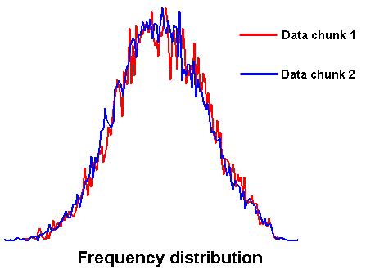
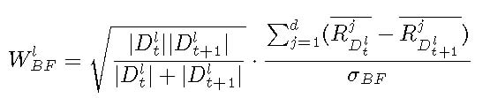
48
Abrupt Concept Drift Detection
Statistical Analysis: Compute a suitable statistic, which is sensitive to data class distribution changes between the two sets of examples.

Slide 49
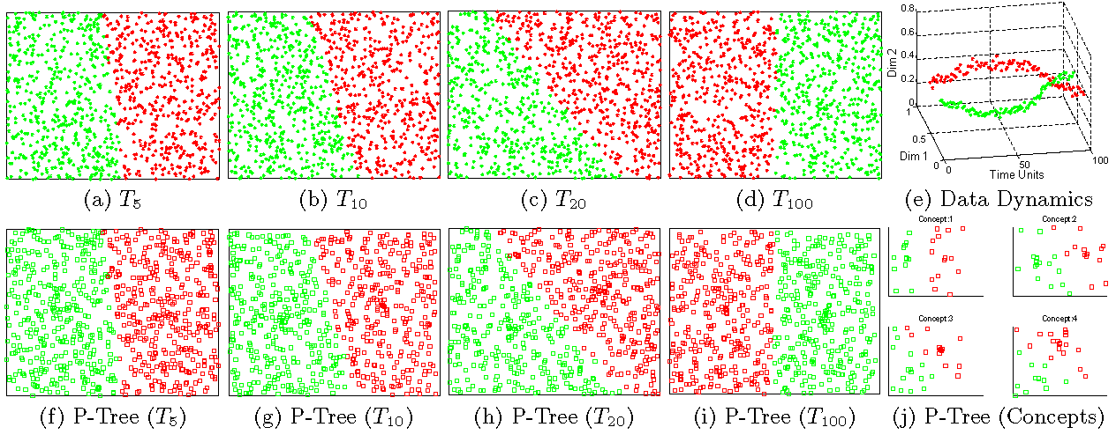
49
Proof of Concept
Concept Modeling
(1) Synthetic data stream with gradual concept drift

Slide 50
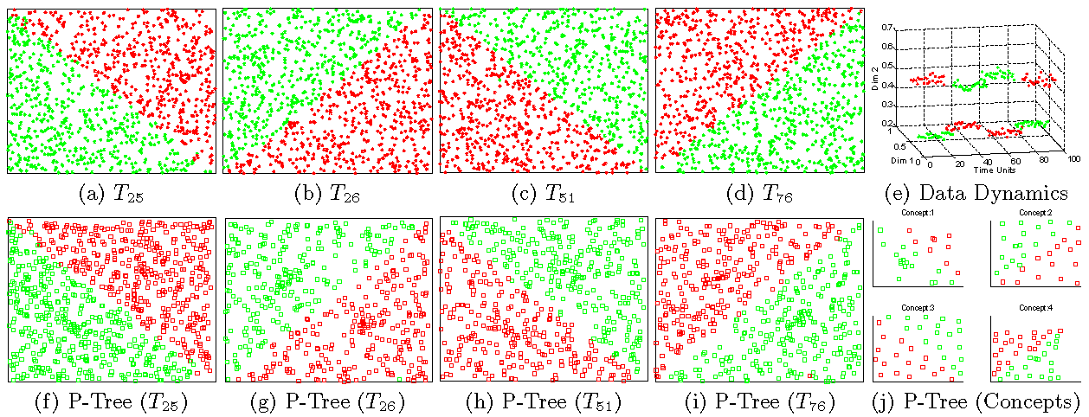
50
Proof of Concept
(2) Synthetic data stream with sudden concept drift

Slide 51
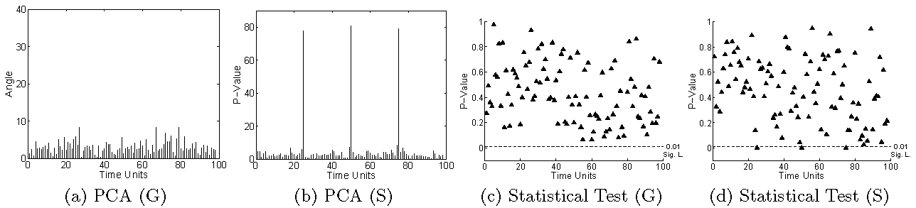
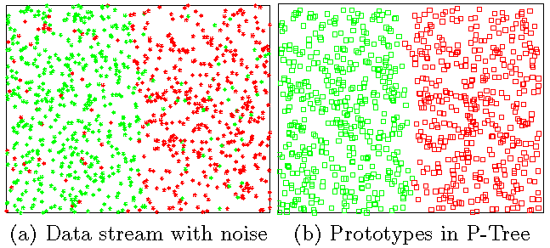
51
1. Proof of Concept
Sudden concept drift detection
Prototype-based Data Representation

Slide 52
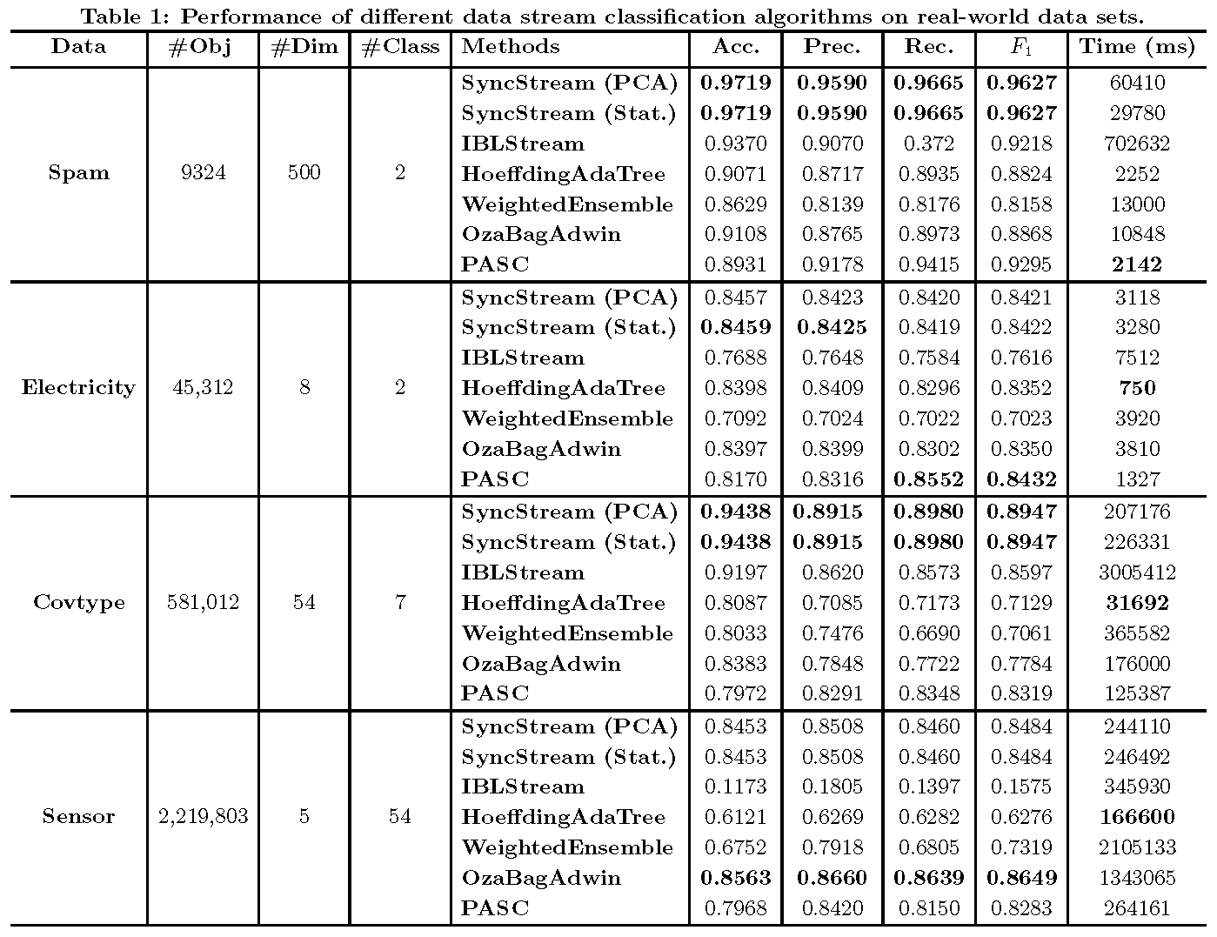
52
Prediction Performance Analysis

Slide 53
Learning on Open-set Data

Slide 54
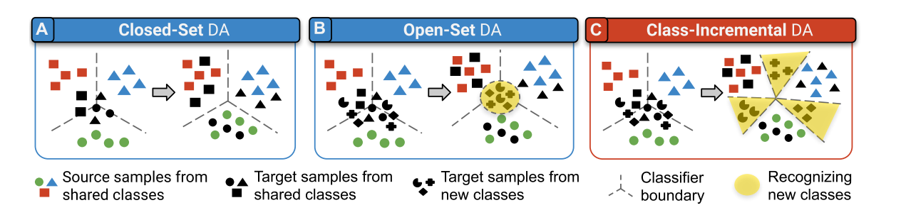
Learning on Open-set Data
Part 1. Open-set detection
Part 2. Incremental Learning

Slide 55
Learning in Open-set Data Stream
World with Knowns (K) & Unknowns Unknowns (UU)
NU: Novel Unknowns
LU: Labeled Unknowns
Incremental Class Learning
K: Known
Detect as Unknown
Label Data
Scale
Human
Recognize as Known
Part 1
Part 2
Part 1. Open-set detection
Part 2. Incremental Learning

Slide 56
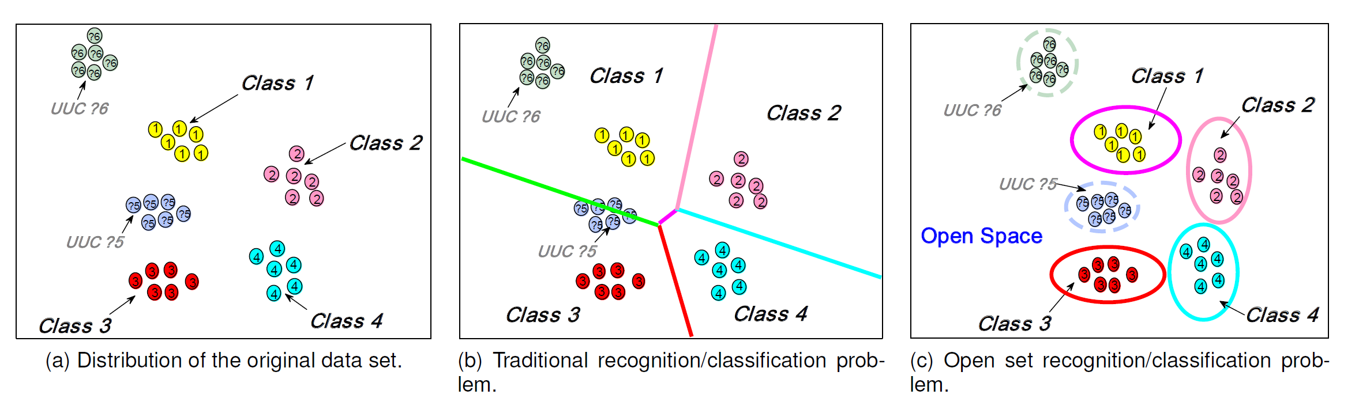
Open set detection
UUC: unknown unlabeled class
Scenario
Incomplete knowledge of the world exists at training time, and unknown classes can be submitted to test set.
Task
Not only accurately classify the seen classes, but also effectively deal with unseen ones.

Slide 57
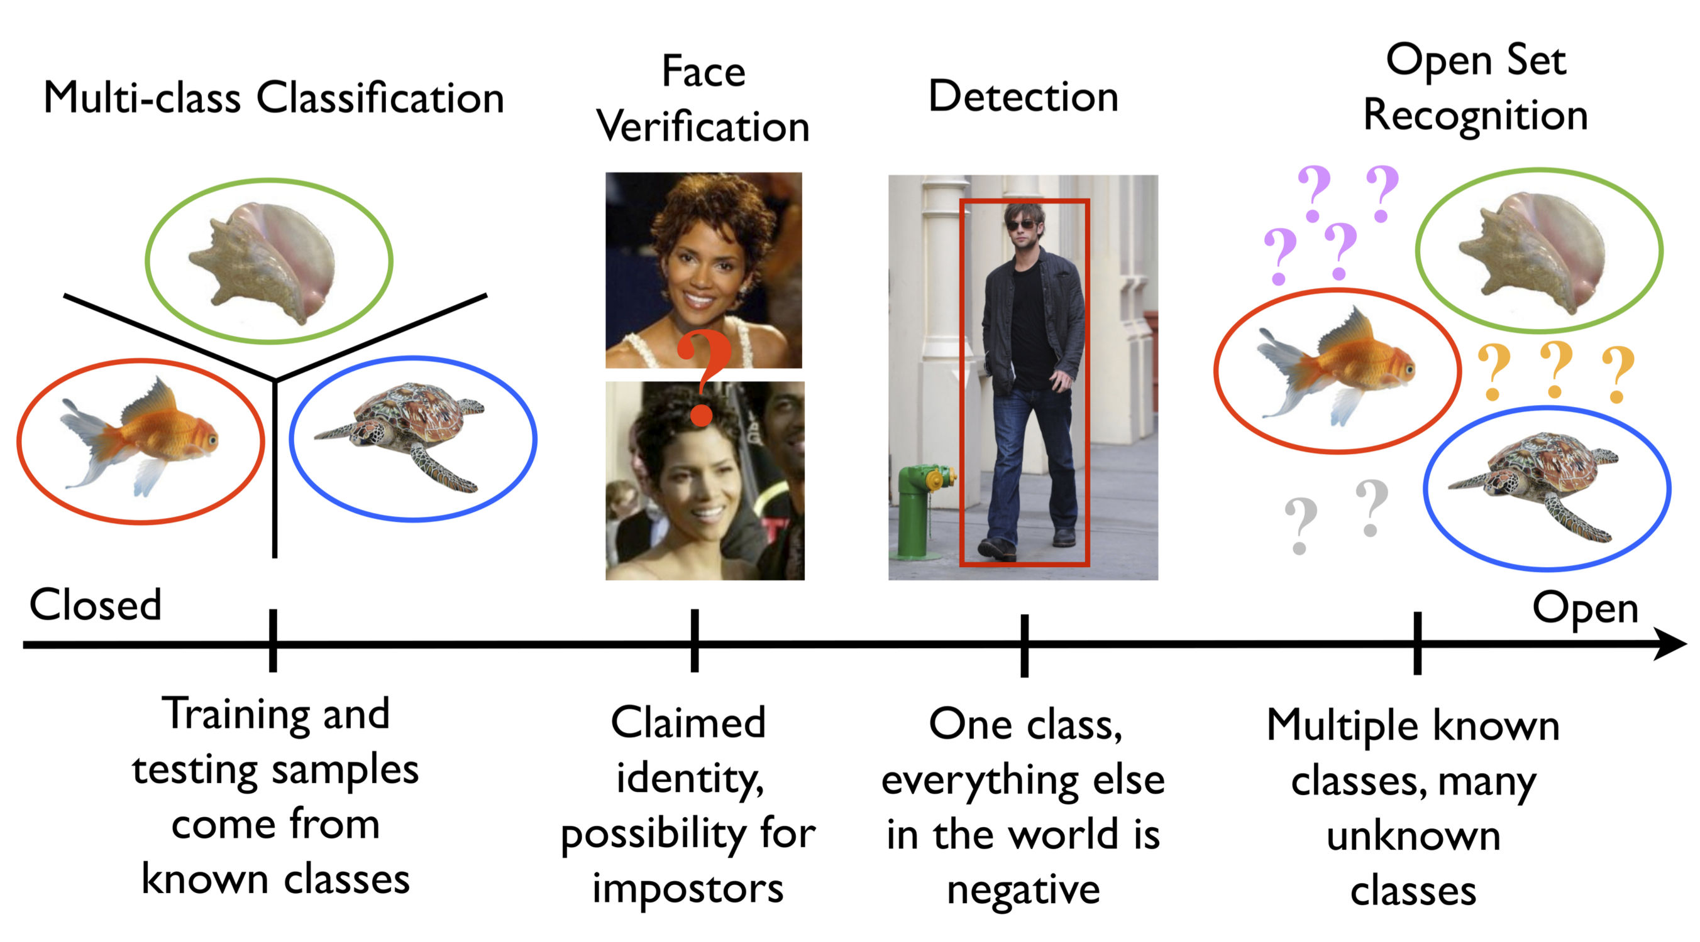
Open set detection

Slide 58
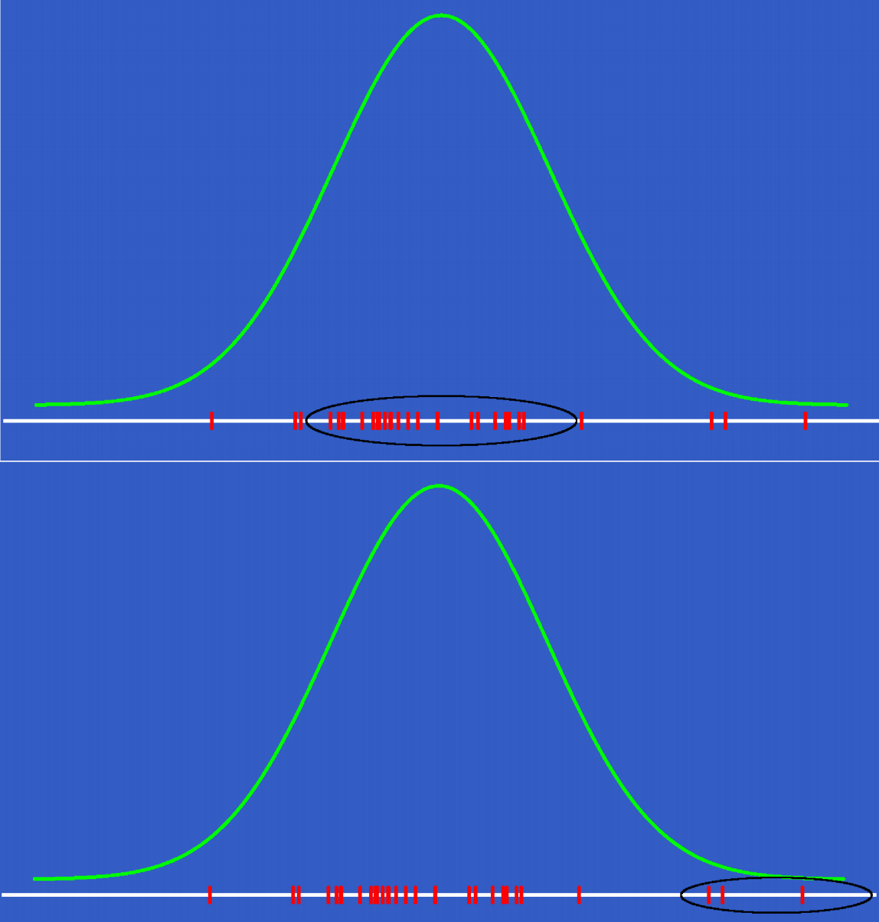
Extreme Value Theory
In classical statistics:
focus on AVERAGE behavior of stochastic process
Central Limit Theorem
In extreme value theory:
focus on extreme and rare events
Fisher-Tippett Theorem
(Extreme Value Theory)
Notes:
在开集识别问题中，对于输入数据提取特征之后，就要分别特征是否属于已知类。很常见的思想是选取一个阈值用于划分已知类与未知类。但是阈值应该如何选取呢？这时候就会经常用到极值理论。
极值理论跟中心极限定理类似，描述的是任意分布在样本量很大的时候的一种共同趋势。不同的是，中心极限定理描述的是整个分布，而极值理论描述的是样本中极值（最大最小值）的概率分布。

Slide 59
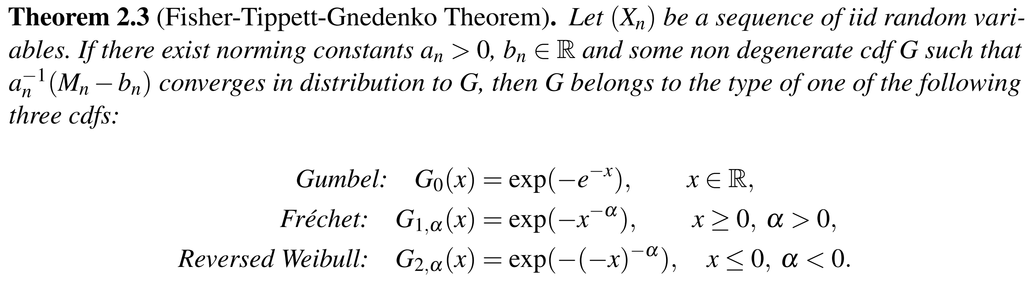
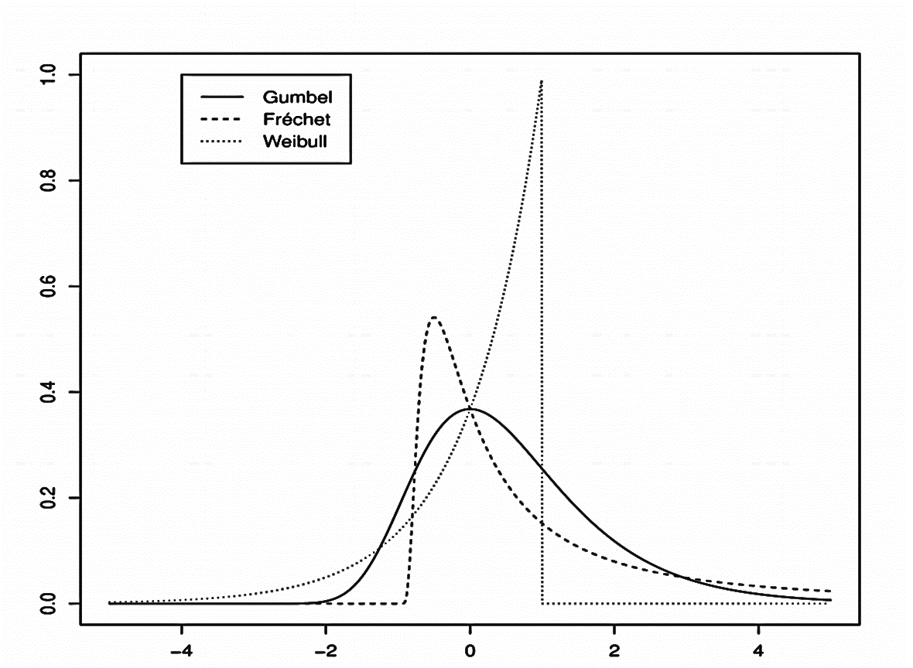
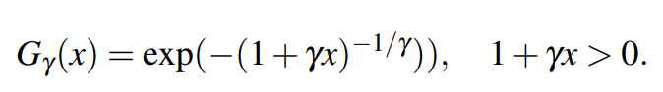
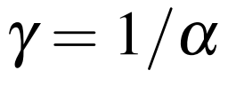
Extreme Value Theory
CDF
General CDF

Slide 60
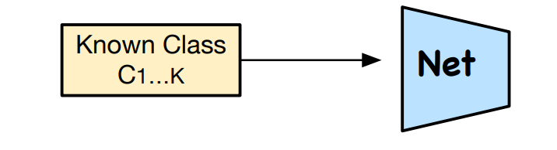
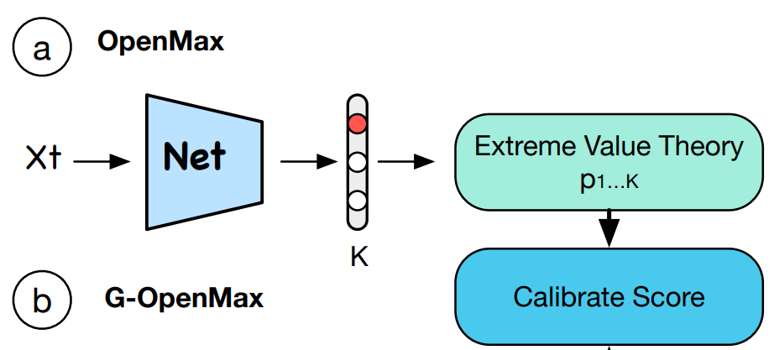
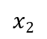
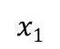
OpenMax
Towards Open Set Deep Networks CVPR 2016
Pre-Network Training
Output Score Calibration
$$x2$$
Fit Weibull Distribution
Class 1 mean
Train
Compute distance between class mean and activation vectors in feature space
Fit distances to Weibull Distribution
Test
Calibrate output score by Weibull model
Classify or Reject
Class 2 mean
$$x1$$
Notes:
Baseline：The first stage leverages EVT as a base theory and fit the known classes’ post recognition activations to a Weibull distribution
利用来自预训练的深度神经网络的倒数第二层的激活矢量。使用EVT从每个类的平均值建模这些激活矢量的距离，生成更新的倒数第二矢量（称为OpenMax）,这个更新的矢量产生了更好的模型，用于识别未知的类测试样本。即以前的CNN中倒数第二层使用SoftMax概率描述，但是并没有产生开集识别的良好模型，为适应开放式环境，更新倒数第二层矢量。
（EVT：极值理论，能够处理小概率事件，预测极端事件的概率。使用EVT的原因：使用EVT建模技术对来自网络的重构误差分布进行建模，从而进一步提高性能。）
https://blog.csdn.net/herr_kun/article/details/107361104

Slide 61
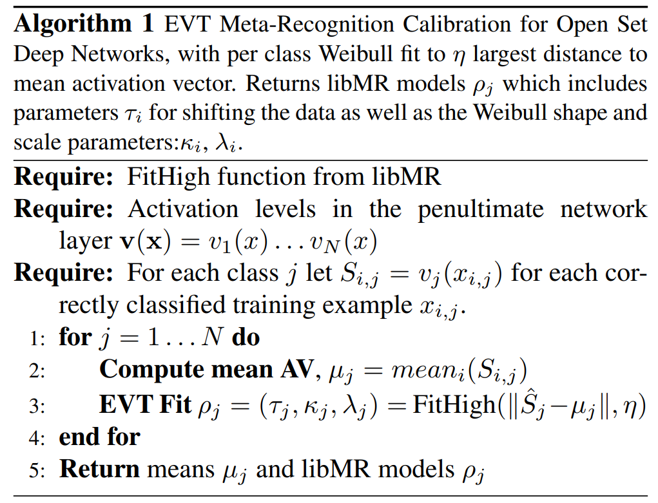
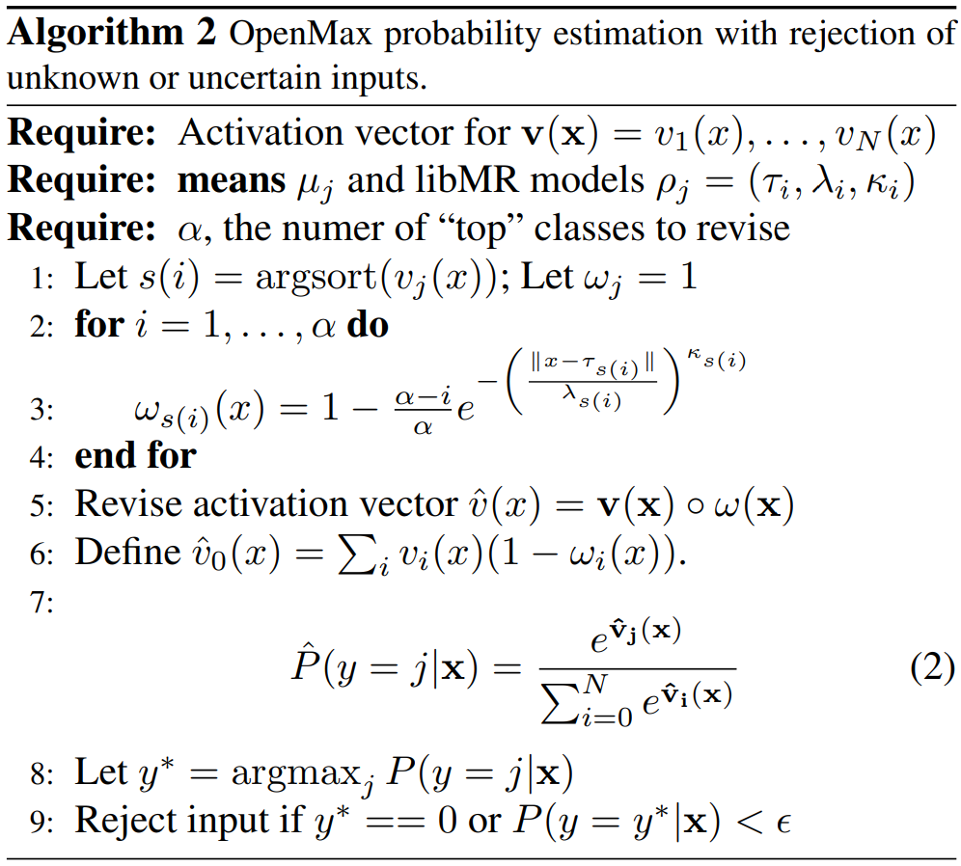
OpenMax
Training Stage:
Fit Weibull distribution
Testing Stage
Output Score Calibration
FitHigh Function: Weibull Fit
Notes:
FitHigh：libmr工具包里逆韦伯分布拟合
Baseline：The first stage leverages EVT as a base theory and fit the known classes’ post recognition activations to a Weibull distribution
利用来自预训练的深度神经网络的倒数第二层的激活矢量。使用EVT从每个类的平均值建模这些激活矢量的距离，生成更新的倒数第二矢量（称为OpenMax）,这个更新的矢量产生了更好的模型，用于识别未知的类测试样本。即以前的CNN中倒数第二层使用SoftMax概率描述，但是并没有产生开集识别的良好模型，为适应开放式环境，更新倒数第二层矢量。
（EVT：极值理论，能够处理小概率事件，预测极端事件的概率。使用EVT的原因：使用EVT建模技术对来自网络的重构误差分布进行建模，从而进一步提高性能。）
https://blog.csdn.net/herr_kun/article/details/107361104

Slide 62
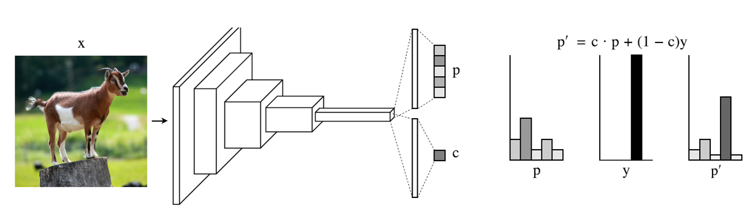
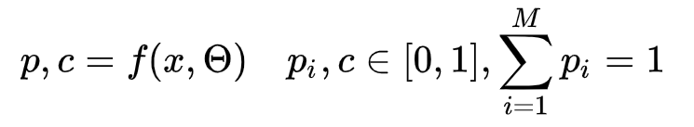
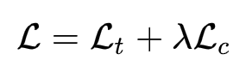
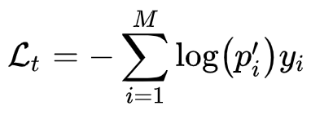
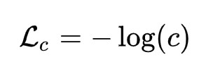
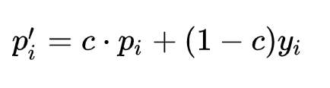
Network for Confidence Estimation
Learning a network that can directly output confidence
- Output prob and confidence
- Overall loss
- Revise prob by confidence
Prevent c from zero
DeVries et,al. Learning Confidence for Out-of-Distribution Detection in Neural Networks, arXiv, 2018
Notes:
同时得到分类结果和信心分数
在原来的神经网络上加了一个输出c作为原来的输出p（预测结果）的信心得分。
为了在训练时，给网络一些提示(hints)，使用置信度c来调整 softmax 预测概率(如上图右边部分所示)
为了阻止网络最小化分类 loss 时总是选择 c=0，添加一个对数惩罚项，即置信度loss，使用二分类的交叉上熵loss，希望置信度总设为1，表示网络总是非常自信的
通过训练，模型会不断提升分类性能，同时可以根据置信度c来衡量输入的数据是否为 ID 样本。

Slide 63
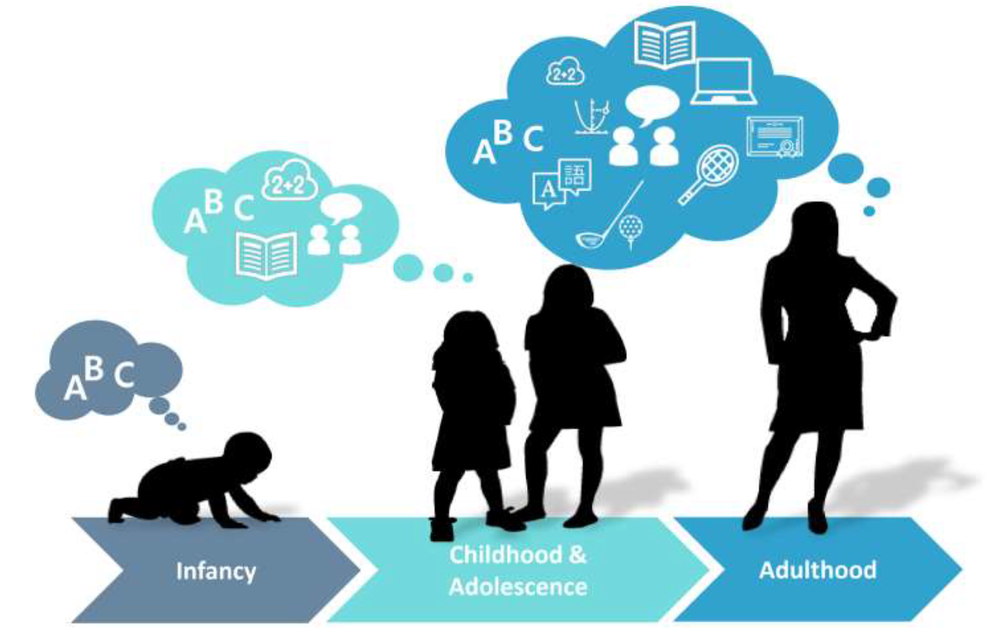
Continual learning
Humans learn throughout their lives and retain/use the previously learned knowledge when learning for a new task

Slide 64
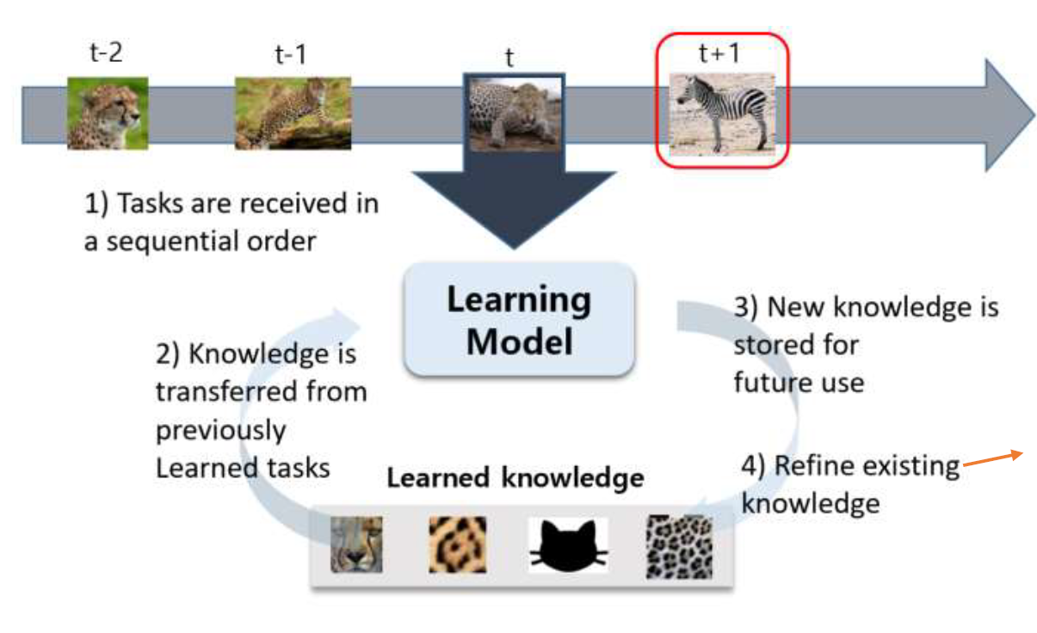
Continual learning
Humans become increasingly smarter over time. Couldn’t we build a similar system that basically learns forever?
- Refine means we
adapt the learned
models with new data
- Weights of learn models
could change to generalize
the new data

Slide 65
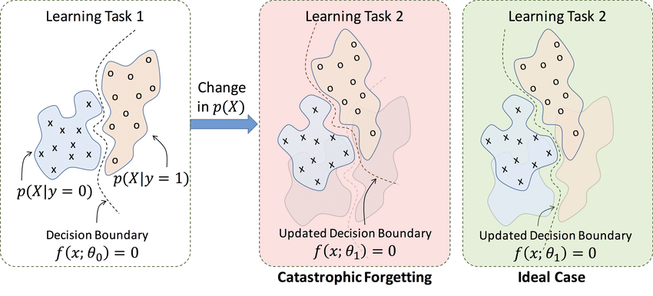
Catastrophic Forgetting
Catastrophic Forgetting
The tendency of an artificial neural network to completely and abruptly forget previously learned information upon learning new information.
Notes:
Catastrophic Forgetting（灾难性遗忘）:即学习了新的知识之后，几乎彻底遗忘掉之前训练的内容。
简言之，关注的是在Sequential Learning过程中，在每个stage的学习中，算法都会使用不同的数据或任务，学习了新的任务或数据会使旧的任务性能大幅下降的问题。更具体来说，例如在分类任务中，我们首先使用一些预定的类别的样本训练一个模型，之后再使用一些新类别的样本来finetune这样一个网络，这会使网络识别初始类别的性能大幅度下降；再比如，在增强学习任务中，单独训练后续的任务，会使agent在前序任务的性能下降严重。

Slide 66
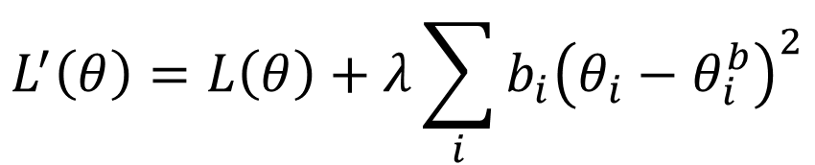
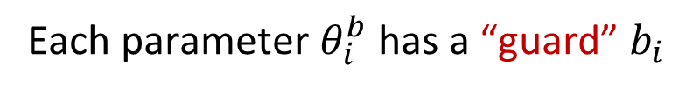
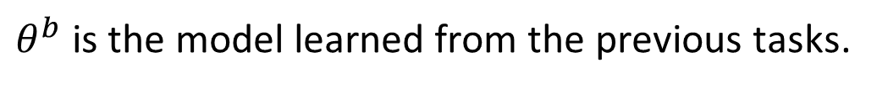
Elastic Weight Consolidation (EWC)
(Kirkpatrick, et al. PNAS 2017
from Google DeepMind)
Basic Idea: Some parameters in the model are important to the previous tasks. Only change the unimportant parameters.
$θ^{b}$ is the model learned from the previous tasks.
Each parameter $θ_{i}^{b}$ has a “guard” $b_{i}$
How important this parameter is
Loss for current task
$$L^{′}\left(θ\right)=L\left(θ\right)+λ\sum_{i}{b_{i}{\left(θ_{i}−θ_{i}^{b}\right)}^{2}}$$
Loss to be optimized
Parameters to be learning
Parameters learned from previous task
Notes:
弹性权重巩固
固定重要的权重，改变对原任务影响不大的权重
多加一项正则项

Slide 67
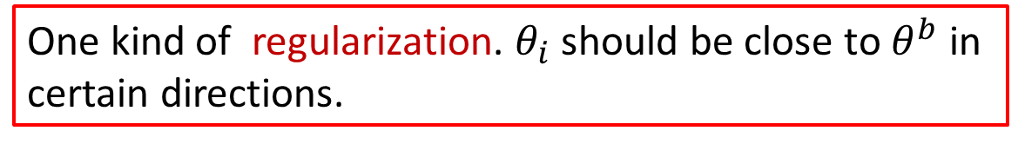
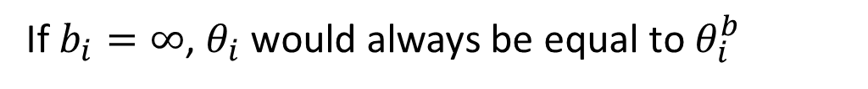
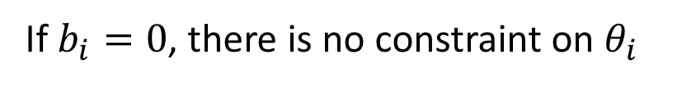
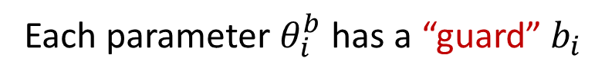
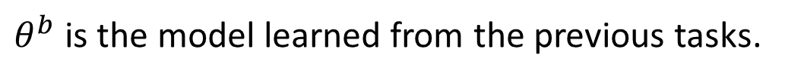
Elastic Weight Consolidation (EWC)
(Kirkpatrick, et al. PNAS 2017
(Kirkpatrick, et al. PNAS 2017
from Google DeepMind)
Basic Idea: Some parameters in the model are important to the previous tasks. Only change the unimportant parameters.
$θ^{b}$ is the model learned from the previous tasks.
Each parameter $θ_{i}^{b}$ has a “guard” $b_{i}$
One kind of regularization. $θ_{i}$ should be close to $θ^{b}$ in certain directions.
$$L^{′}\left(θ\right)=L\left(θ\right)+λ\sum_{i}{b_{i}{\left(θ_{i}−θ_{i}^{b}\right)}^{2}}$$
If $b_{i}=0$, there is no constraint on $θ_{i}$
If $b_{i}=∞$, $θ_{i}$ would always be equal to $θ_{i}^{b}$
Notes:
弹性权重巩固
固定重要的权重，改变对原任务影响不大的权重
多加一项正则项

Slide 68
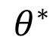
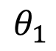
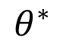
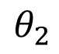
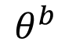
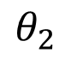
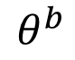
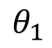

Elastic Weight Consolidation (EWC)
(Kirkpatrick, et al. PNAS 2017)
Task 1
Task 2
$$θ^{0}$$
$$θ^{∗}$$
$$θ^{∗}$$
$$θ_{2}$$
$$θ_{2}$$
Forget!
$$θ^{b}$$
$$θ^{b}$$
$$θ_{1}$$
$$θ_{1}$$
The error surfaces of tasks 1 & 2.
(darker = smaller loss)
Notes:
两个任务 网络简单 两个参数 error surface
先学task1 初始化theta_0 学习到 theta_b
继续学任务2 直接用theta_b finetune 参数到了task2 error surface的中心
这样反过来对任务1 loss变大了 这就是灾难性遗忘

Slide 69









Elastic Weight Consolidation (EWC)
(Kirkpatrick, et al. PNAS 2017)
Task 1
$$θ_{1}^{b}$$
$$θ^{0}$$
$$θ_{1}$$
Small 2nd derivative
$b_{1}$ is small
$θ_{1}$ can change
$$θ_{2}$$
$$θ_{2}^{b}$$
$$θ^{b}$$
$$θ_{1}$$
$$θ_{2}$$
Large 2nd derivative
Each parameter has a “guard” $b_{i}$
$b_{2}$ is large
$θ_{2}$ can’t change
Notes:
每个参数计算二次微分
改变Theta1 对结果影响不大
Theta 2 二次微分大 改变参数对loss影响大，更新时固定
这个二次微分只是其中一种限制方式

Slide 70




Elastic Weight Consolidation (EWC)
(Kirkpatrick, et al. PNAS 2017)
(Kirkpatrick, et al. PNAS 2017
Task 1
Task 2
$$θ^{0}$$
Do not forget!
$$θ^{∗}$$
$$θ_{2}$$
$$θ_{2}$$
$$θ^{∗}$$
$$θ^{∗}$$
$$θ^{b}$$
$$θ^{b}$$
$$θ_{1}$$
$$θ_{1}$$
$b_{1}$ is small, while $b_{2}$ is large.
($θ_{1}$ can move, not$θ_{2}$)
Notes:
通过EWC约束收敛到theta*

Slide 71


Elastic Weight Consolidation (EWC)
(Kirkpatrick, et al. PNAS 2017)
(Kirkpatrick, et al. PNAS 2017
Notes:
如上图所示，如果我们只是简单地进行sequential learning，也就是fine-tuning on task B，那么参数的移动方向将会是中间那条no penalty的蓝色路线，然后我们就完全忘记了task A，sad！
因而，我们就需要进行评估到底哪个参数对结果的影响更大，即需要找到一些参数，对它们的改变不会对我们对任务A的表现有影响，但是却可以显著提升task B的效果。
如果我们把所有的参数设置为相同的权重，那么参数的移动方向将会是下面那条绿色的线，这样我们只会记住任务A而完全无法学习任务B，而理想的移动策略应该是上方红色的那条线。
这样，当我们手里有training，validation，test三个集合的时候，我们用validation集合计算task A的loss然后backward就可以取得每个参数的相关梯度，然后保存他们的绝对值或者平方，这个数值越大我们就认为他们对A任务更重要，我们就会在任务B的学习中较少的改动他们，参数就会沿着red line走了，

Slide 72

Elastic Weight Consolidation (EWC)
Elastic Weight Consolidation (PNAS 2017)
Synaptic Intelligence (JMLR 2017)
Incremental Moment Matching (NIPS 2017)
Memory Aware Synapses (ECCV2018)
Rotated EWC (ICPR 2018)
Quadratic EWC (PNAS 2018)
OnlineEWC (ICML2018)
Different $Fi$
Notes:
SIthe importance scores of each weight is computer online along the learning trajectory
EWC: 利用loss的二次导数
MAS: 用输出y的二阶导数，中间位置偏导数 不需要label 只需要x
IMM:就是KL散度，拉普拉斯估计
OnlineEWC: 把EWC和progressnet结合到一起，提出了onlineEWC，解决随着任务变多，正则化数量变多的问题
RotatedEWC: EWC has the drawback that it assumes the Fisher Information Matrix to be diagonal – a condition that is almost never true
rotating the parameter space 矩阵理论
Quadratic Penalties in Elastic Weight Consolidation
EWC对于两个以上的任务，可能重复计算

Slide 73











Gradient Episodic Memory (GEM)
(Lopez-Paz, et al. NIPS 2017)
Constraint the gradient to improve the previous tasks
$$g$$
$$g$$
$$g^{1}$$
as close as possible
$$g′$$
$$g^{2}$$
$$θ$$
$$θ$$
$$g^{2}$$
: negative gradient of current task
$$g′∙g^{1}≥0$$
$$g^{1}$$
$$g′∙g^{2}≥0$$
negative gradient of previous task
Need the data from the previous tasks
: update direction
Notes:
学习当前任务时，可以访问之前所有任务的部分数据，它们被收集在一个称为“episodic memory”的地方
可以理解成用之前训练的任务对当前训练任务进行正则化，继而修正当前模型更新的梯度方向 (即获得投影结果g ‘ )。

Slide 74






Class incremental learning
Data sequence from different classes
Data batch 1
Data batch 2
Data batch 3
Exemplars
Class: 0,1
Exemplars
Class: 0,1,2,3
Model 1
Model 2
Model 3
Issues:
How to balance old/new class
How to maintain old knowledges
How to extract exemplars

Slide 75
Class incremental learning
Data sequence from different classes
Data batch 1
Data batch 2
Data batch 3
Exemplars
Class: 0,1
Exemplars
Class: 0,1,2,3
Model 1
Model 2
Model 3
Issues:
How to maintain old knowledges

Slide 76








Knowledge Distillation
- Knowledge distillation is a popular CIL technique:
old output logits
new output logits
Total loss function:
Notes:
imbalanced old/new class training data, where the out- put layer is biased towards new classes
Overfit new
Pc(x) is the output probability for the c th class.
Qc(x) represents the output logits of the old model obtained in the previous incremental step
The distilling loss is computed for all samples from the new classes and exemplars from the old classes

Slide 77


Basic Idea
Maintaining Discrimination and Fairness in Class Incremental Learning. CVPR 2020
- For maintaining discrimination
Knowledge distillation
- Maintaining fairness issues:
Imbalanced data
Old/new task performance trade-off
Notes:
imbalanced old/new class training data, where the out- put layer is biased towards new classes
Overfit new
Another issue is the dilemma to balance the contribution between Lce and Lkd,

Slide 78






Weight Aligning
- Firstly, we rewrite the weights in the FC layer in the following form
where
- Then, the norms of the weight vectors of old classes and new classes as follows
- Finally, the corrected output weights:
where
Notes:
权重对齐

Slide 79

How to Extract the Exemplars
Existing methods:
Herding^{[1]} (Nearest class mean)
Random sampling^{[2]}
Learnable pseudo exemplars^{[3]}
[1] Rebuffi, et al. iCaRL: Incremental classifier and representation learning. CVPR 2017.
[2] Wu, et al. Large scale incremental learning. CVPR 2019.
[3] Liu, et al. Mnemonics Training: Multi-Class Incremental Learning without Forgetting. CVPR 2020

Slide 80
3、Data Stream Clustering

Slide 81

Example: Stream Clustering
Topic cluster
Article
Listings

Slide 82
Data stream clustering Framework
Online Phase
Summarize the data into memory-efficient data structures
Offline Phase
Use a clustering algorithm to find the data partition

Slide 83
Micro-Clusters
A Micro-Cluster is a set of individual data points that are close to each other and will be treated as a single unit in further offline Macro-clustering.
View of Micro-Cluster
View of Macro-Cluster

Slide 84
Stream Clustering Algorithms
Data Structures | Examples
Prototypes | Stream, Stream Lsearch
Cluster Feature | CluStream, ClusTree, DenStream, HP-Stream, Scalable k-means
Grids | D-Stream, ODAC
Coreset Tree | StreamKM++

Slide 85
Cluster Feature: CF = (N, LS, SS)
where N: # data points, LS = , SS =
Key Point: Additivity Property

Slide 86
The CluStream Framework
Micro-cluster
Statistical information about data locality
Temporal extension of the cluster-feature vector
Multi-dimensional points with time stamps
Each point contains d dimensions, i.e.,
A micro-cluster for n points is defined as a (2*d + 3) tuple
Pyramidal time frame
Decide at what moments the snapshots of the statistical information are stored away on disk

Slide 87
CluStream: Pyramidal Time Frame
Pyramidal time frame
Snapshots of a set of micro-clusters are stored following the pyramidal pattern
They are stored at differing levels of granularity depending on the recency
Snapshots are classified into different orders varying from 1 to log(T)
The i-th order snapshots occur at intervals of α^{i} where α ≥ 1
Only the last (α + 1) snapshots are stored

Slide 88



Slide 89
CluStream: Clustering On-line Streams
Online micro-cluster maintenance
Initial creation of q micro-clusters
q is usually significantly larger than the number of natural clusters
Online incremental update of micro-clusters
If new point is within max-boundary, insert into the micro-cluster
o.w., create a new cluster
May delete obsolete micro-cluster or merge two closest ones
Offline Phase: Query-based macro-clustering
Based on a user-specified time-horizon h and the number of macro-clusters k, compute macroclusters using the k-means algorithm

Slide 90
DenStream
Microclusters are associated with weights (Decay function) based on recency
Outliers detected by creating separate micro-cluster.
The “dense” micro-cluster (named core-micro-cluster) is introduced to summarize the clusters with arbitrary shape, while the potential core-micro-cluster and outlier micro-cluster structures are proposed to maintain and distinguish the potential clusters and outliers.

Slide 91


Slide 92
Thanks !!!

